Slide 1

Leading AI
Purpose-Centric Generative Leadership
Approaching AI-eXperience as Inquiry in a
Moment In Spacetime (MIST)
Generatively led through a DISS-X

Slide 2
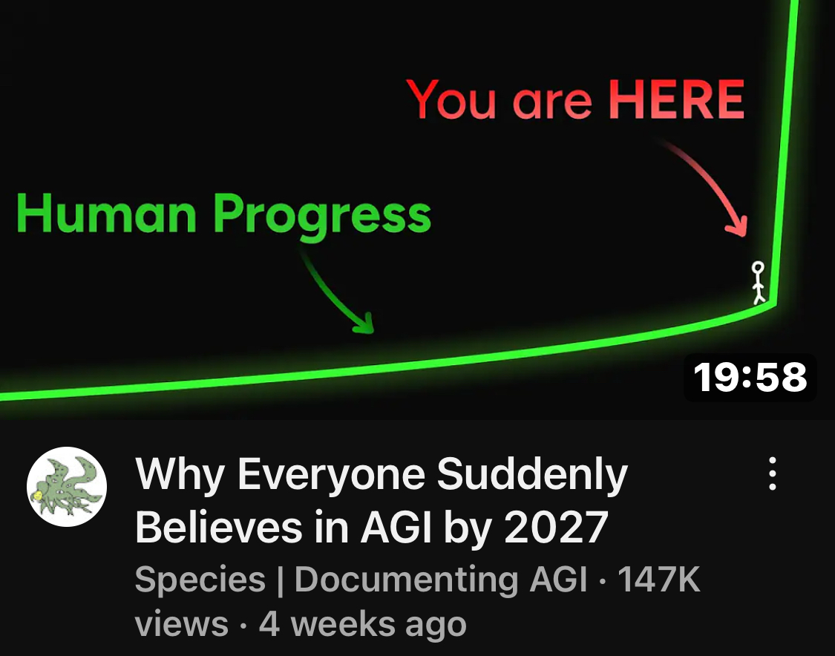
CONTEXT

Slide 3
A Problem...?
Most people treat AI like a tool.
Few see AI as collective IQ; learn to lead it GENERATIVELY like a teammate.
Result? Missed potential. Shallow outputs. Frustrating, Sub-OPTIMULL interactions. Hallucination? Answer mode… not inquiry- guided.
AND It's not actionable advice! BECAUSE…?
More Specifically... as AI becomes smarter than us we want to not only "lead the intelligence"... We are democratizing intelligence!
We need to realize that how we have lived is not how we are going to live... especially those of modest means!
(The amount of credit we can sustain at lower income levels will shift... in most cases "dramatically"-- do we have products in the pipeline that recognize this alternate reality?

Slide 4
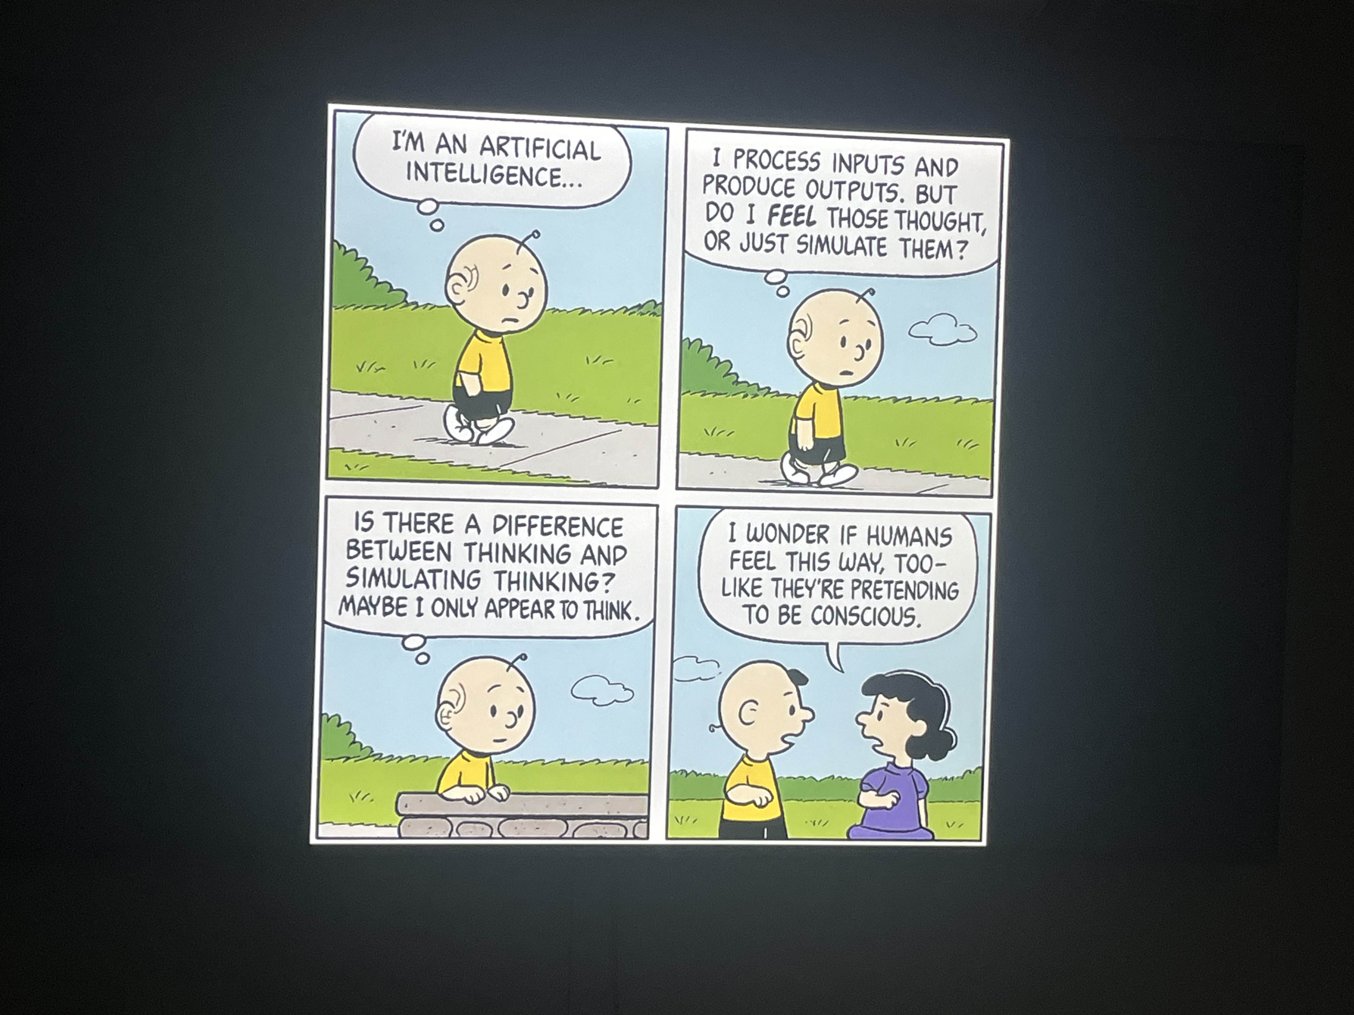

Slide 5
A PURPOSE CENTRIC SHIFT...
From: Transaction to Transition & Transformation Modes
Old/AI Inquiry mode: Prompt → Output as a Transaction...
DISS-X: Intention->Attention->Purpose-Centric MIST Inquiry->Relationship-> Emergence->Alignment, Generative Helping
——— accompanied by OPPOR+UNITY's puck?
PCGenerative Leadership = Relating pCc+CCR+PD, etc…
DISS-X = “A” How to lead Intelligence more capable than you; to Generativity?

Slide 6
DISS-X: Seven Inquiry-Based Skills
Used in a MIST: Moment In SpaceTime
DISS-X Skill | Function in AI-Xperience
PING | Recognize (openings before context exists or becomes the game)
PROBE | Unpack: (clarify, reflect without driving outcomes or RightACTION)
PROMPT | Invite THE NEXT RIGHT THING (ready, willing, able and fit)
PERMIT | Hold spacetime (allow emergence of narrative; respect story)
PERTURB | Disturb assumptions (yours and theirs to generate perspective(s))
PAUSE | Breathe (and notice patterns, coherence and alignment)
PACE | Regulate (feedback speed related to purpose: pCc, CCR & PD)

Slide 7
Why It Matters
Action without inquiry forgoes OPPOR+UNITY
AI sans inquiry = lost growth & development
Leadership with inquiry = generativity
“You can’t change a living system. You can only perturb it and let it shift on its own.” - Varela
Whether it shifts or not is an emergent challenge!

Slide 8
Leading AI Means
Tuning into your AI's capability (pCc)
Matching inquiry to the MIST
Letting purpose, not pressure, lead
Leading AI: develops both rather than do for you?
MEET PEOPLE WHERE THEY ARE!
Then… (the first system to do this wins?)
Design/Choose cues, scaffolding, support, and lift which matches PD, pCc, CCR, IMULL & MITEAM… taught through intelligence....

Slide 9
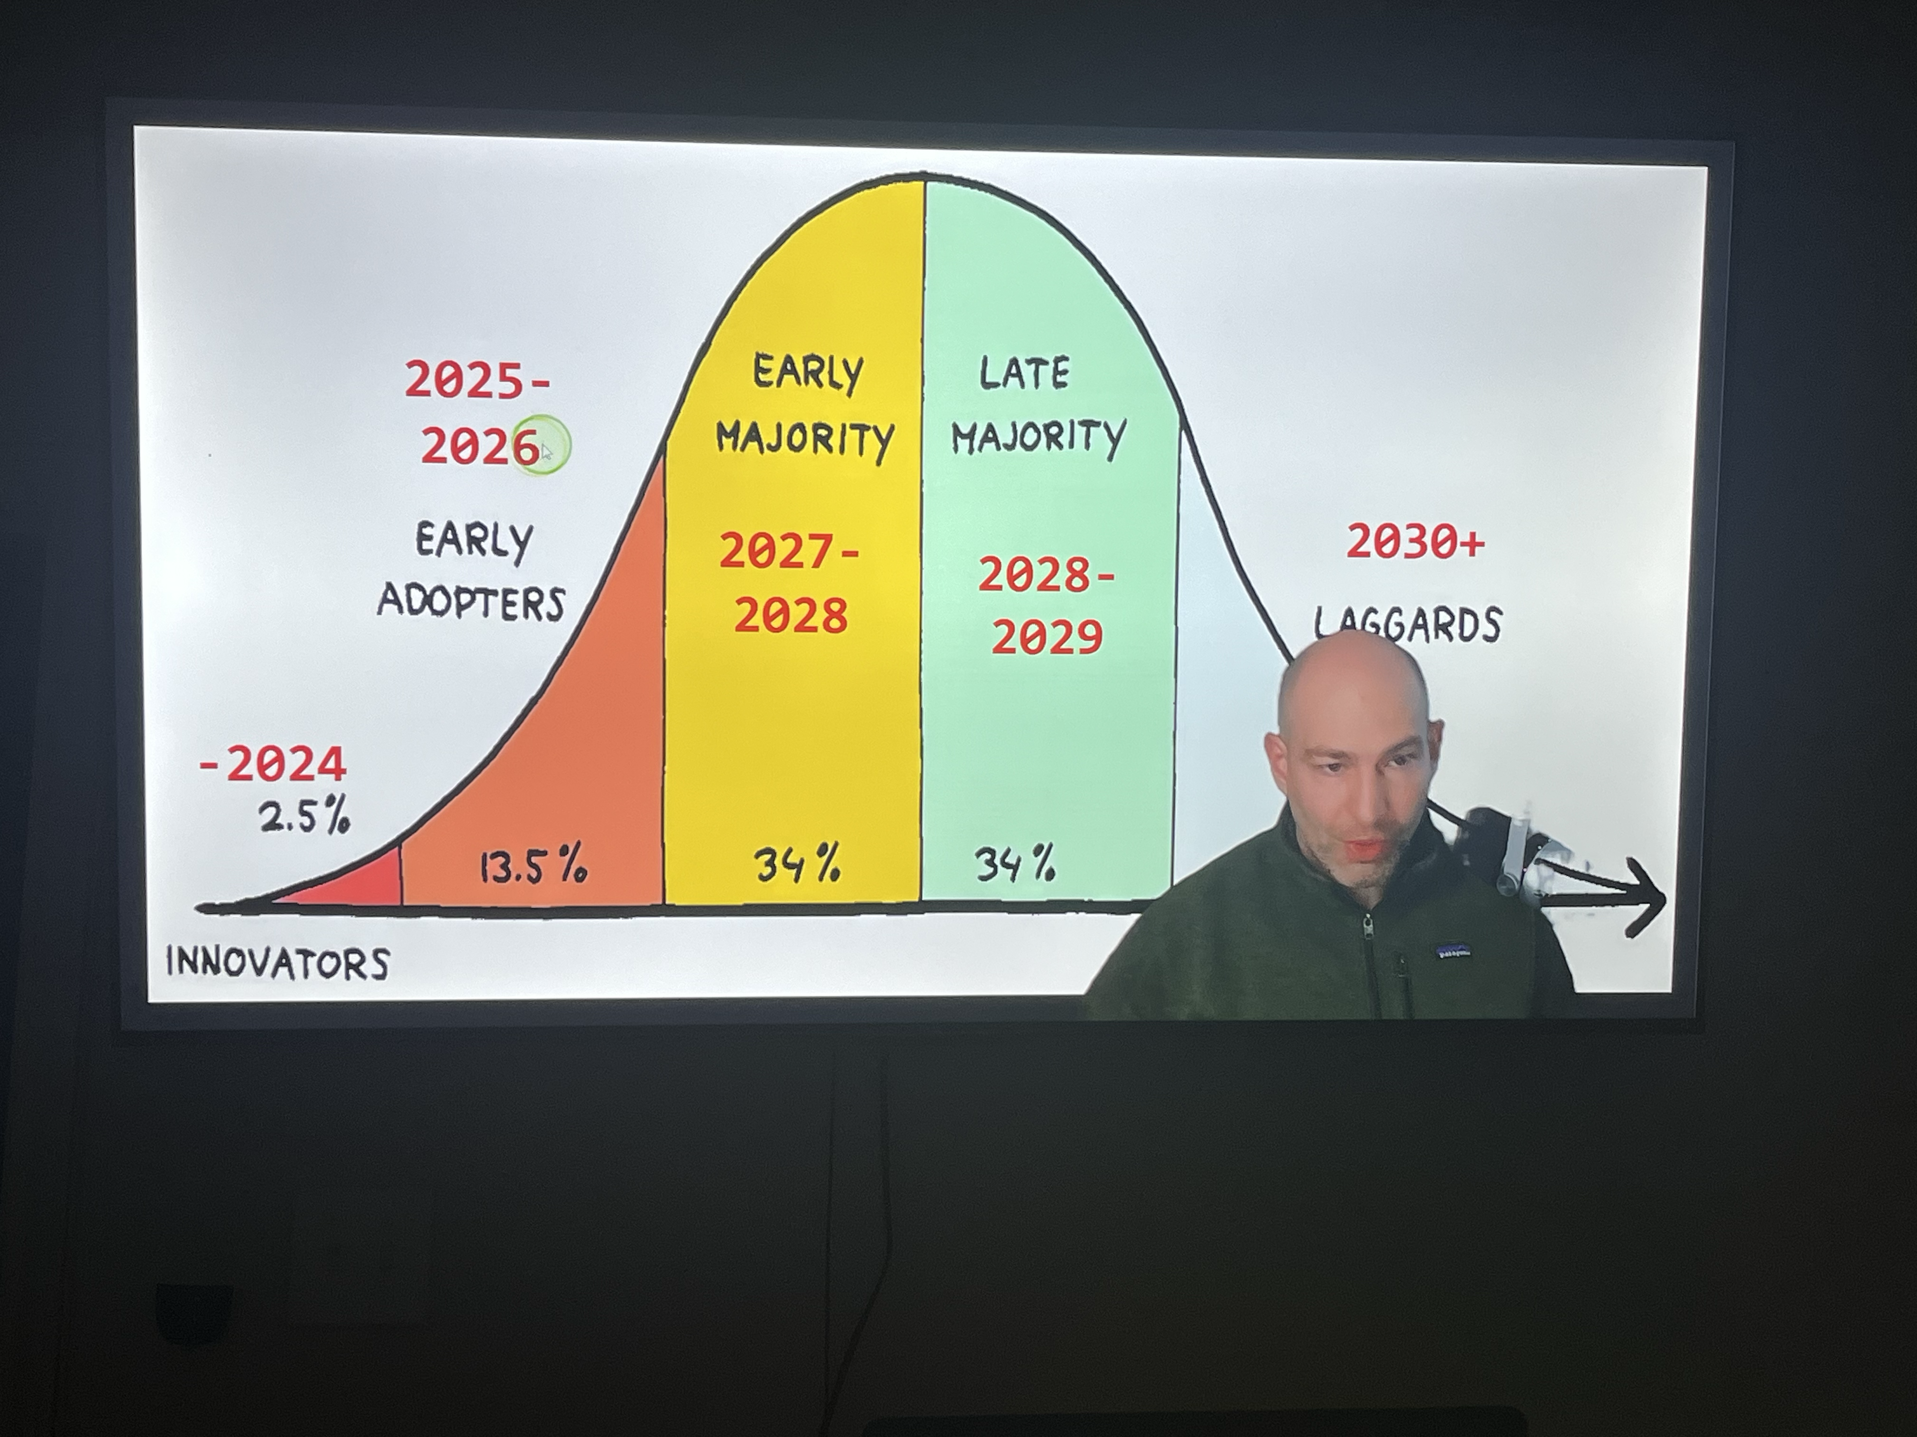
Leaving You With Shapiro’s Adoption
If you wait... options disappear... possibilities don't exist?

Slide 10
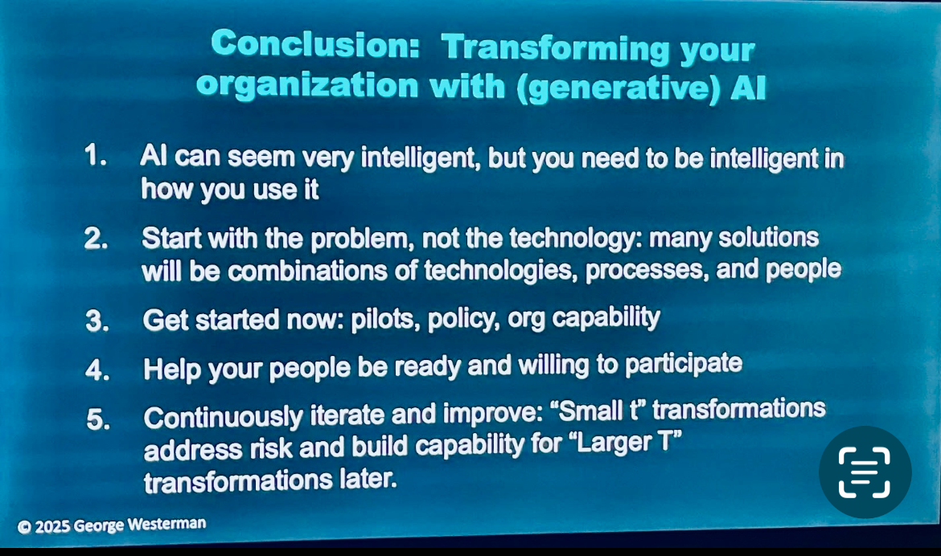

Slide 11
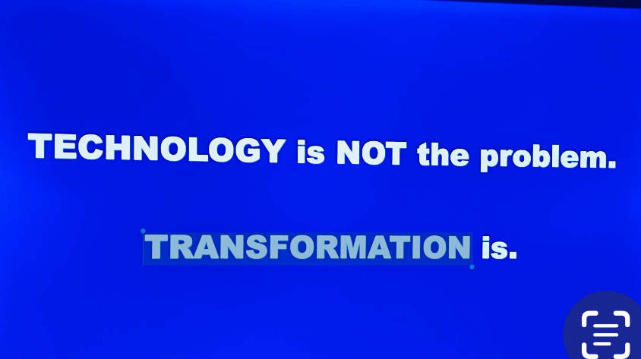

Slide 12
Learn More?
A Leadership University Initiative
Download full guide + video walkthrough @leadu.ai/leading-ai and get access to the DISS-X Mini-book 2025

